Slide 1
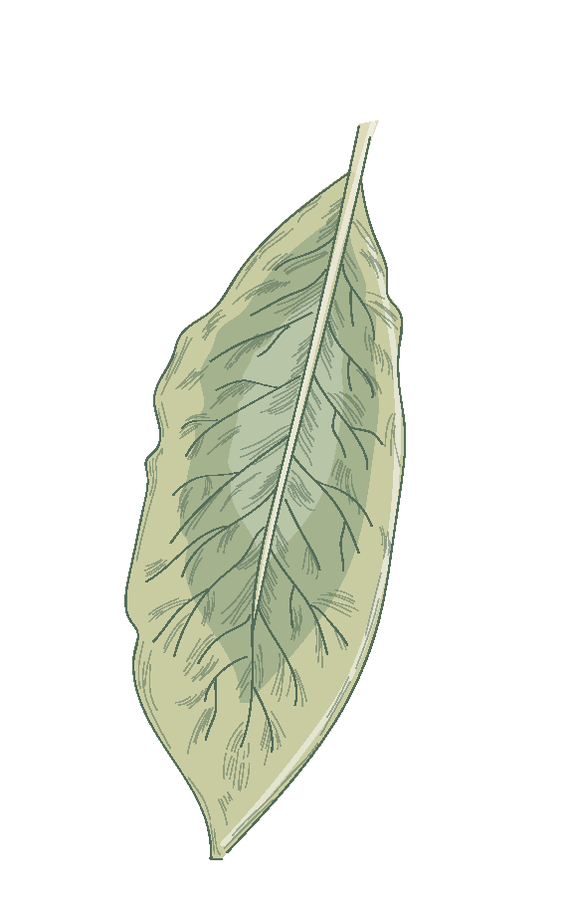
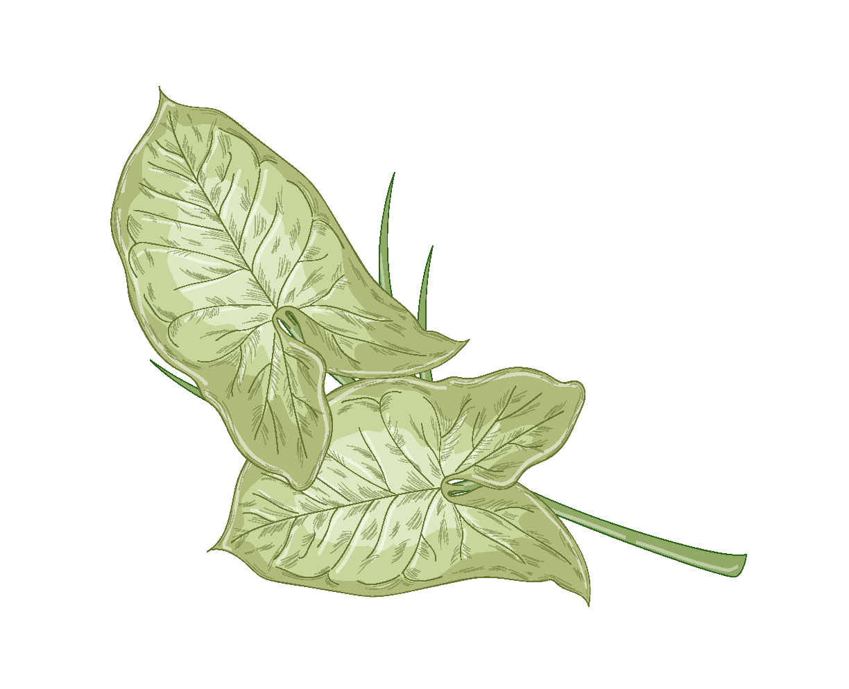
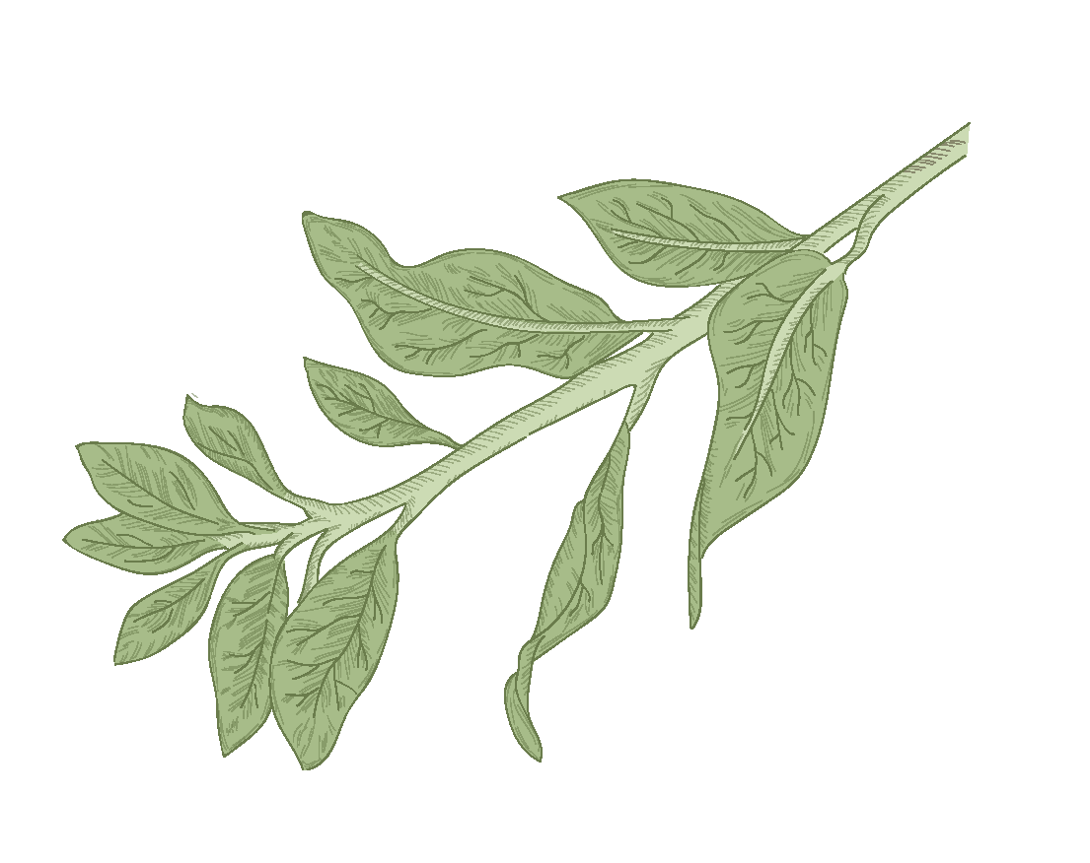

3 PRETTY BUT DEADLY FLOWERS
By: Chariss Reine D. Moreno

Slide 2
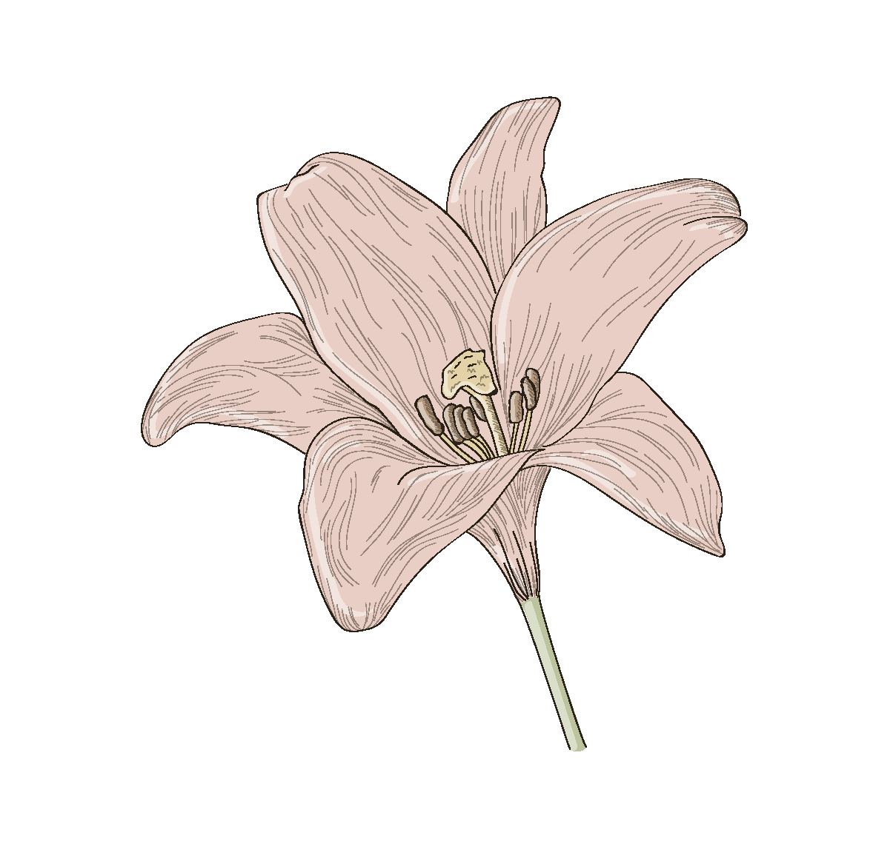
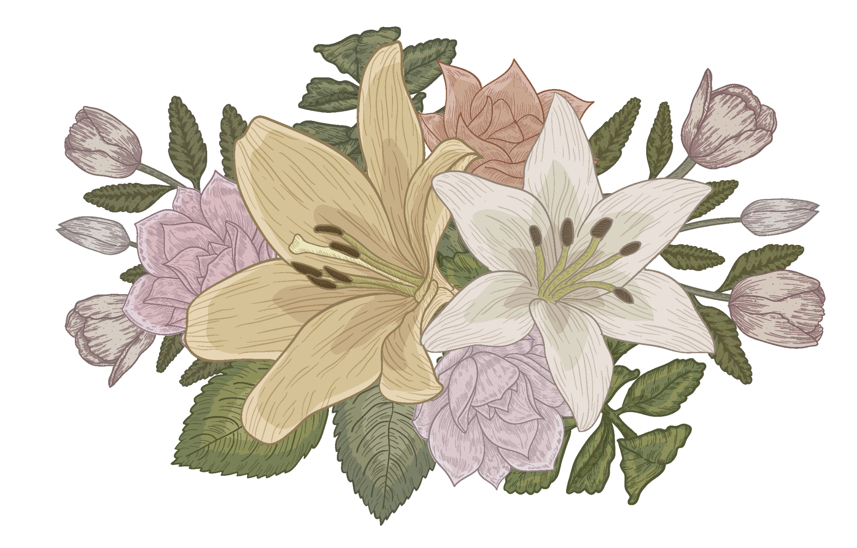
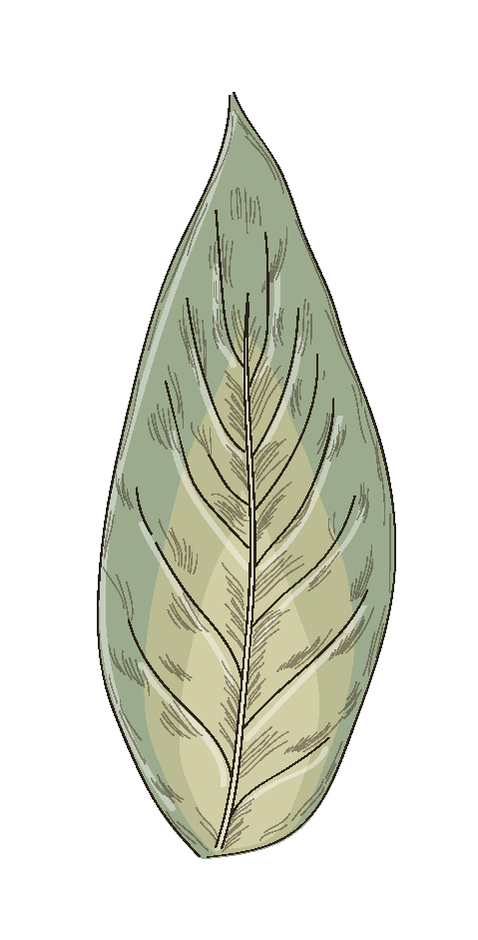
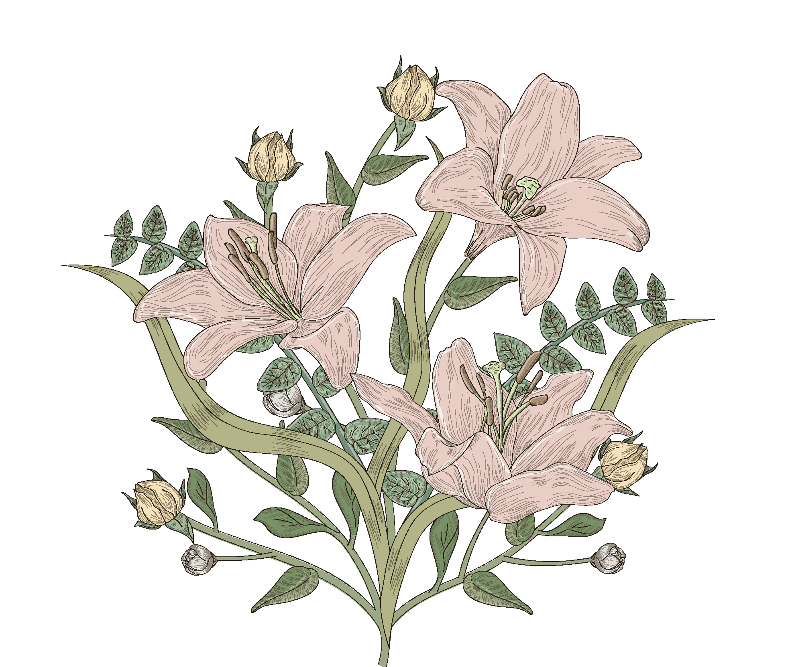

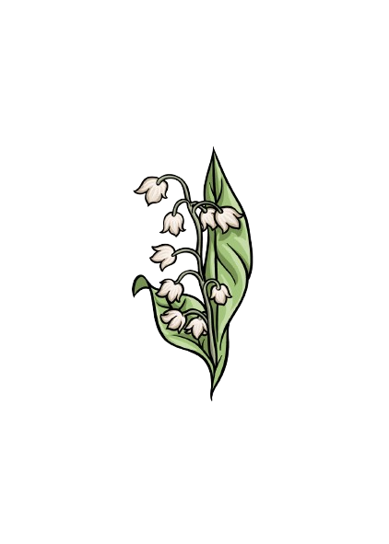
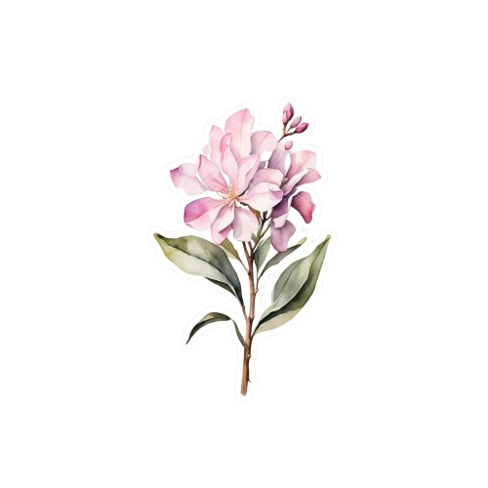
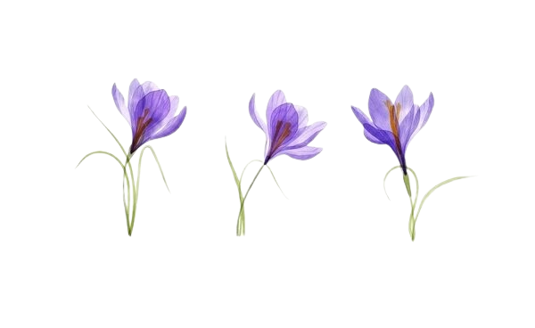
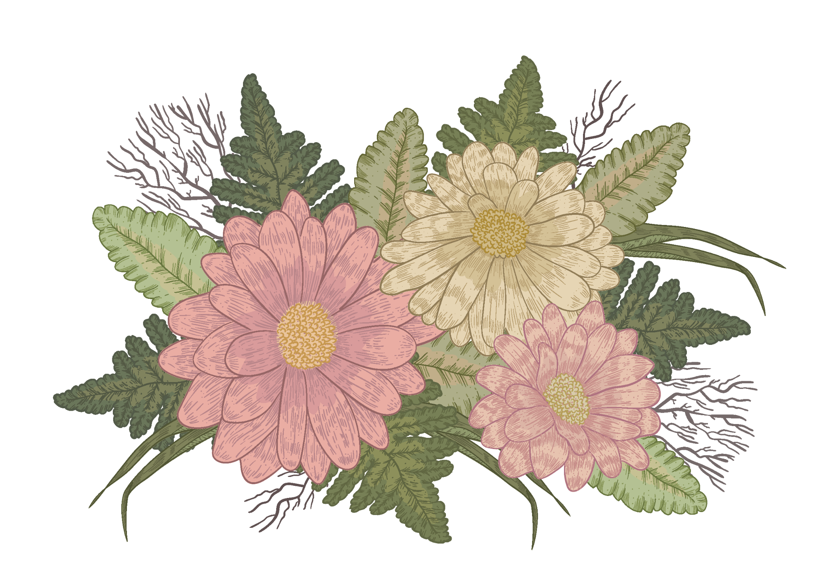

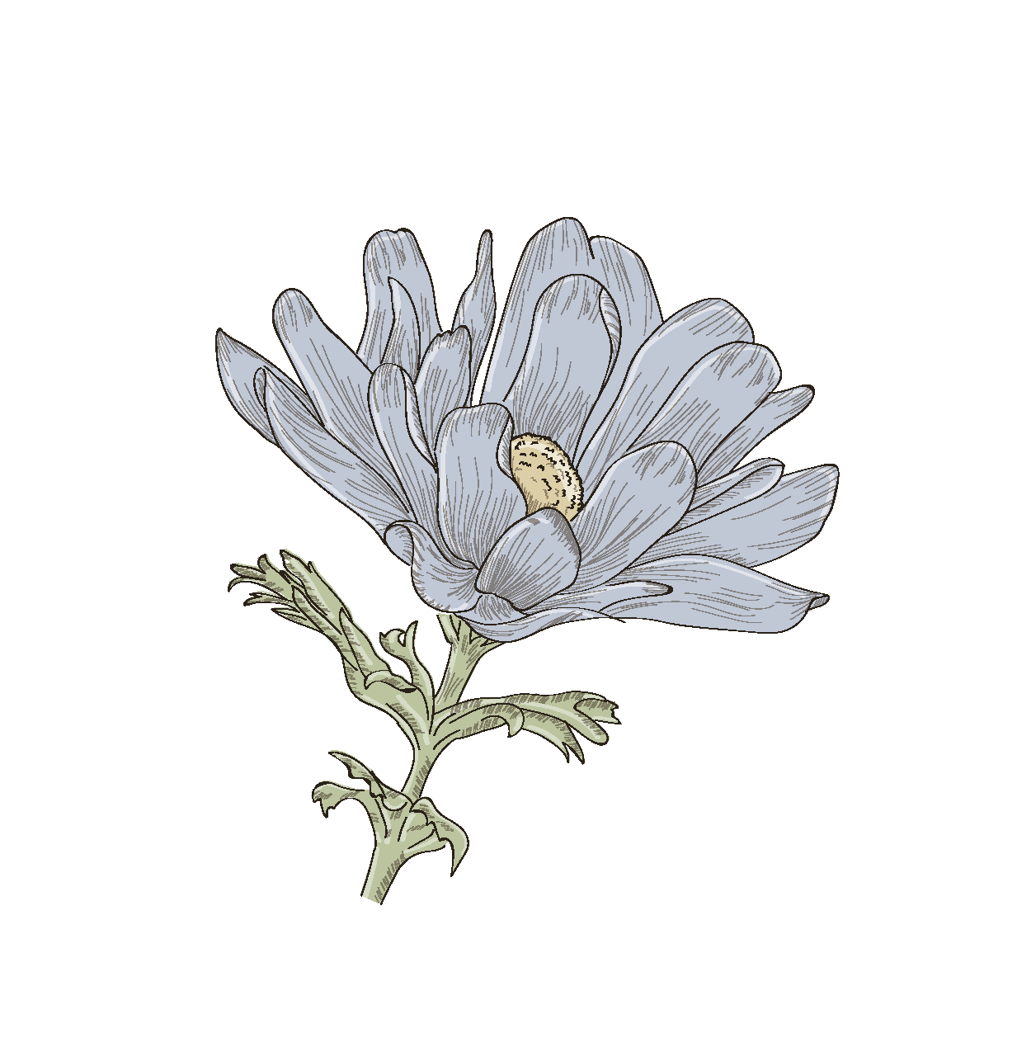
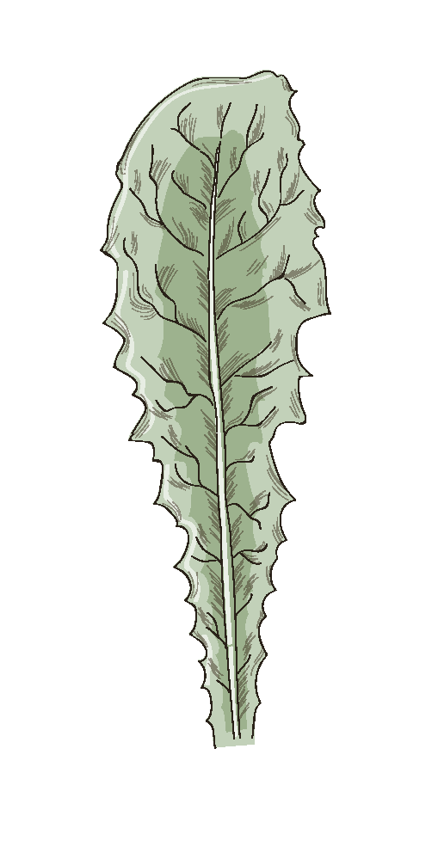
01
click here! (for an animation)
02
03
RESOURCES

Slide 3
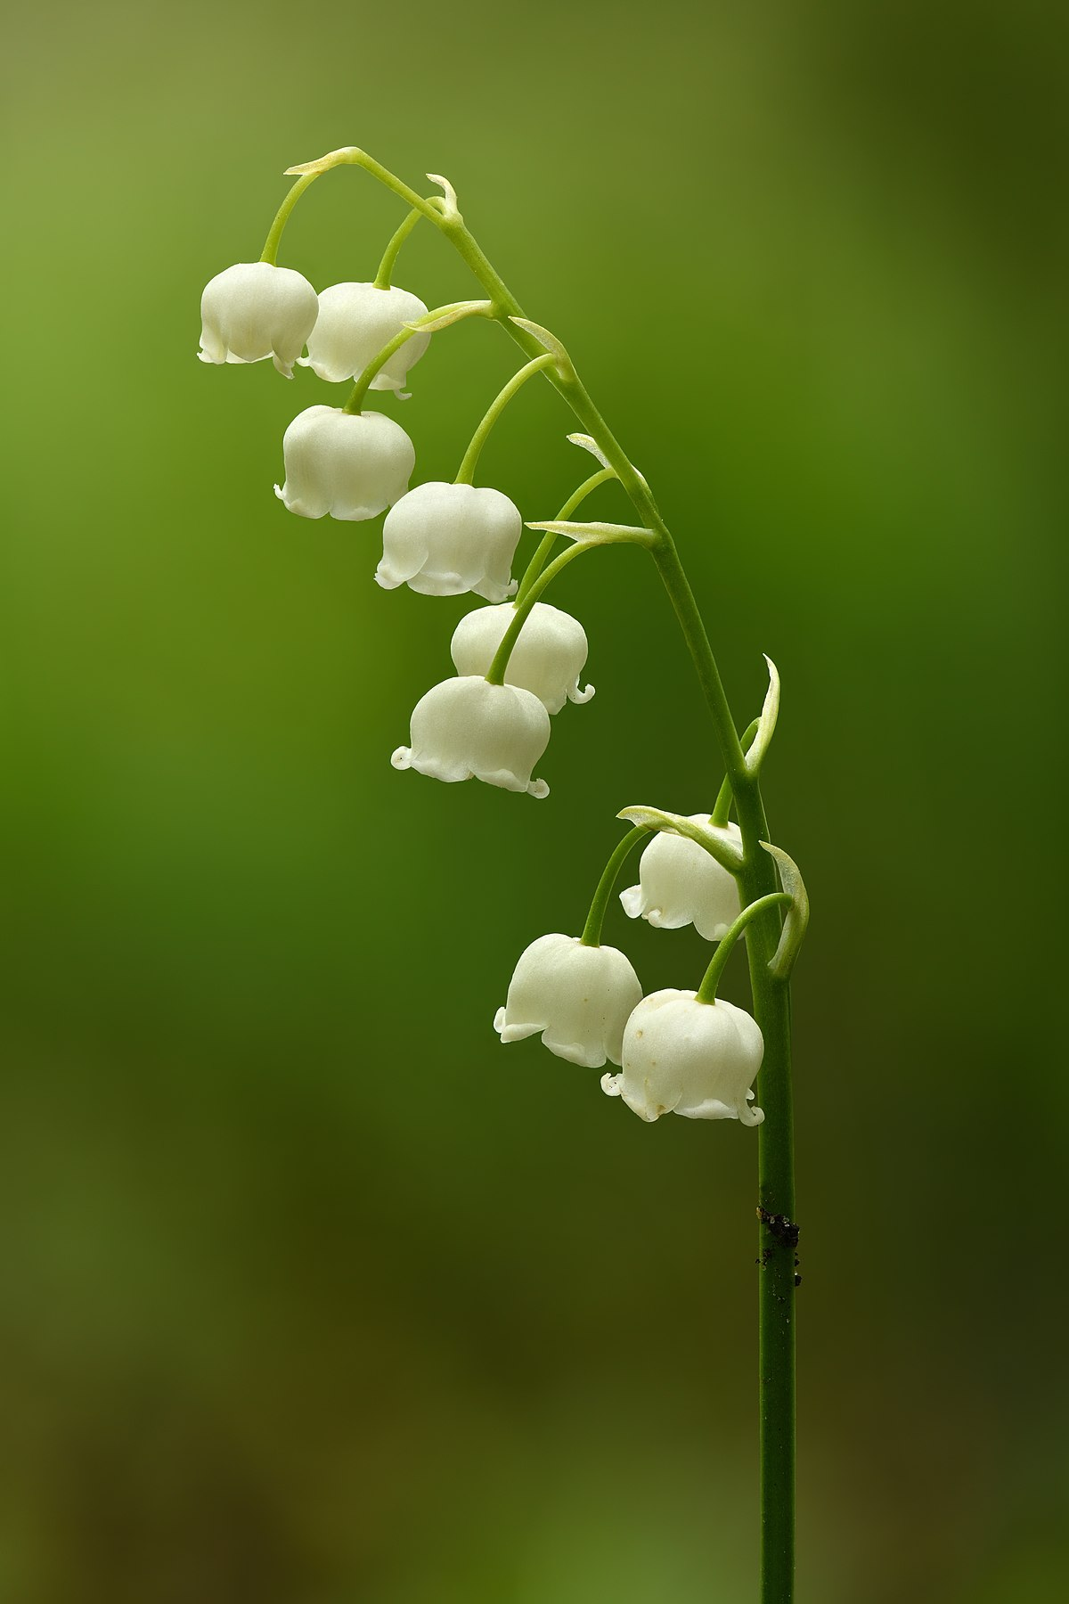
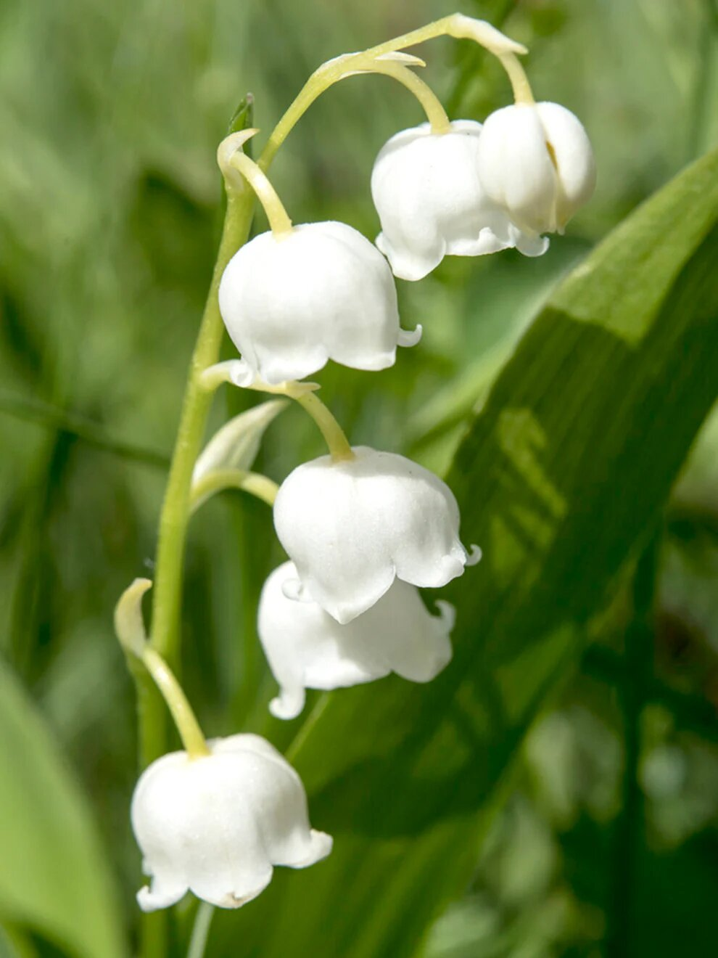
01 Lily of the Valley
Though this may look like an adorable flower, it is extremely toxic if ingested. Some of it’s effects are:
Slow Heartbeat
Blur Vision
Rash
However, it also has a tradition of being featured in weddings (such as Prince William and Catherine Middleton’s wedding).
The effects of this flower is shown in the popular TV series: Breaking Bad.

Slide 4
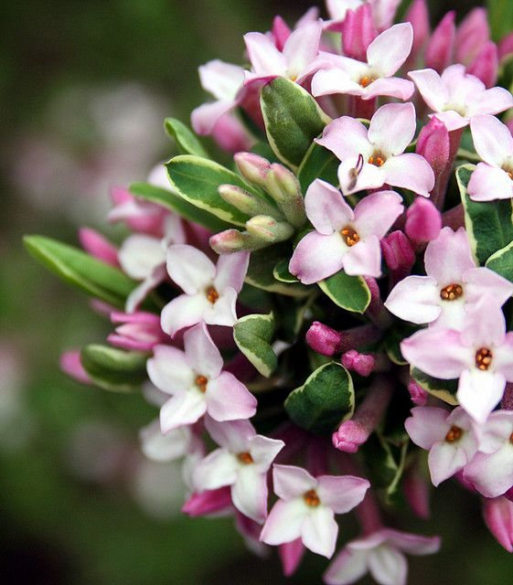
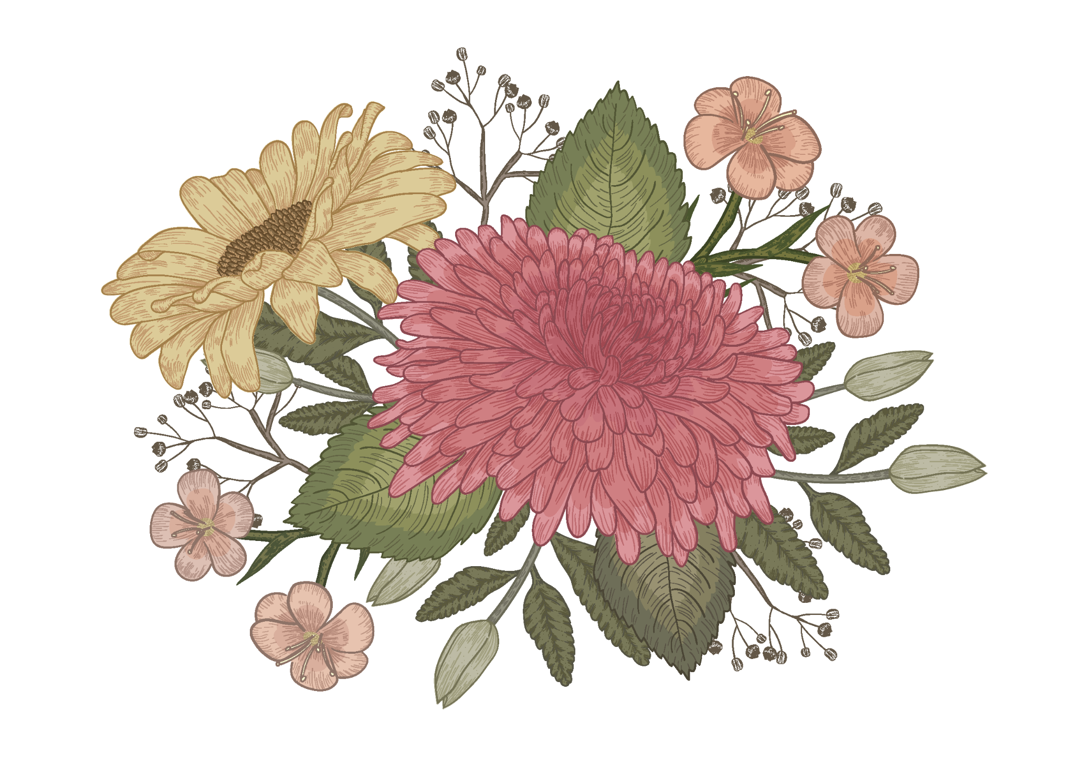
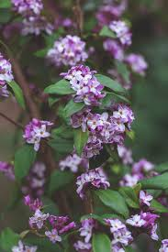
02 daphne
This flower has a very strong aroma to the point it is called “churihyang” in Korea or “thousand mile scent”. It is found in:
Asia
Europe
North Africa
Ingesting 1 or 2 berries may cause an upset stomach, but large amounts may result in:
Mouth and Throat Irritation
Nausea
Abdominal Pain
Diarrhea (may contain blood)
Lack of Appetite

Slide 5
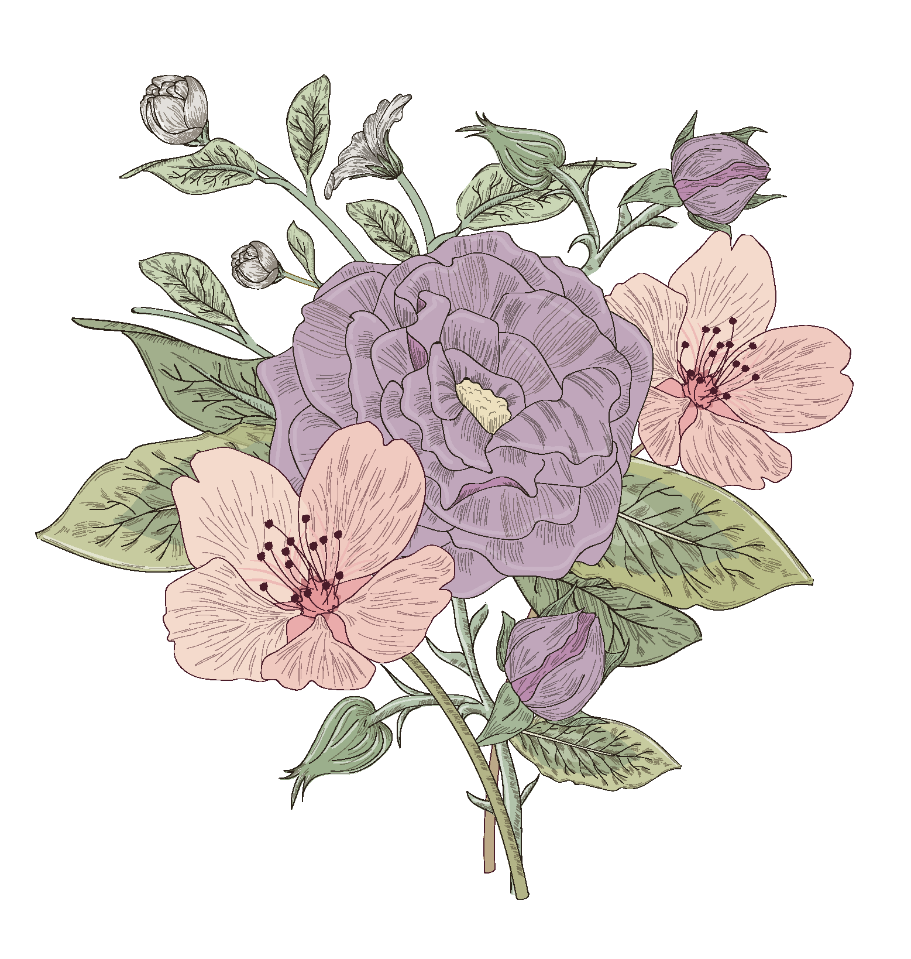
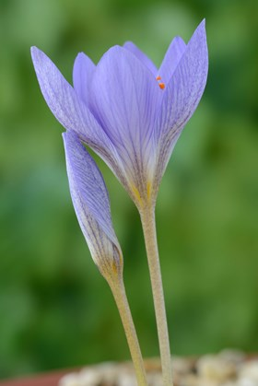
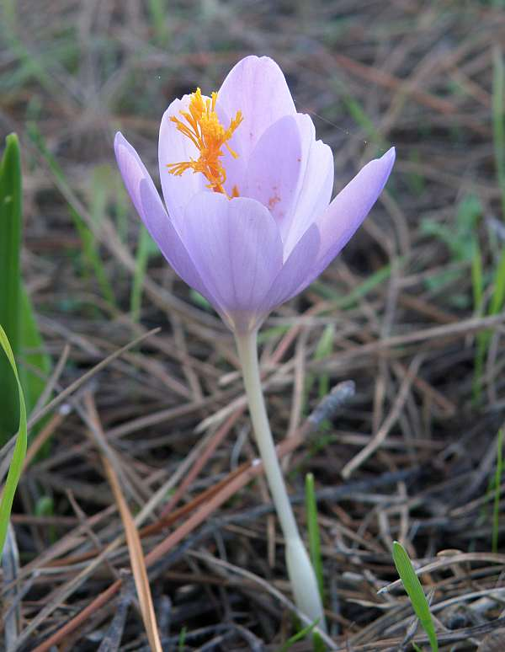
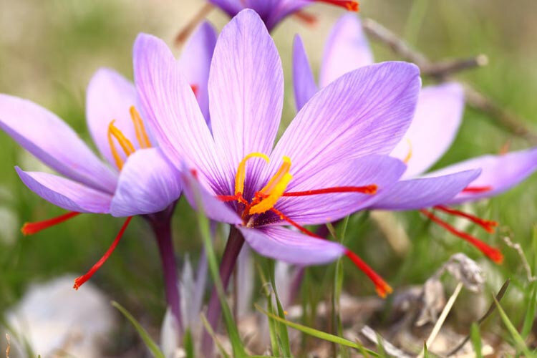
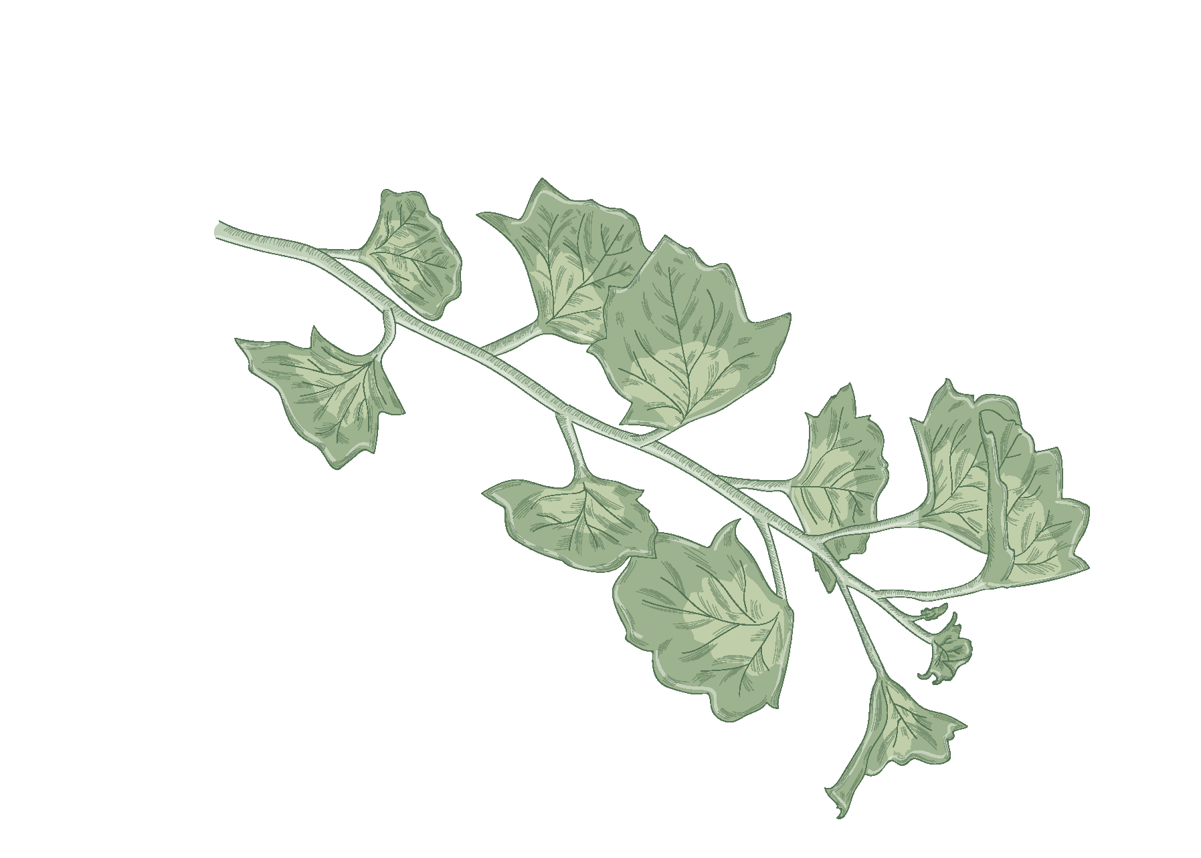
03 autumn crocus
This flower is also known as “Naked Lady”, because of how its flowers don’t bloom until the leaves have died and fallen off. It is also used to symbolize love and fidelity. But in reality in can cause:
Burns in the Mouth
and Throat
Vomiting
Liver
Kidney Problems
Blood Disorders
Organ Failure

Slide 6
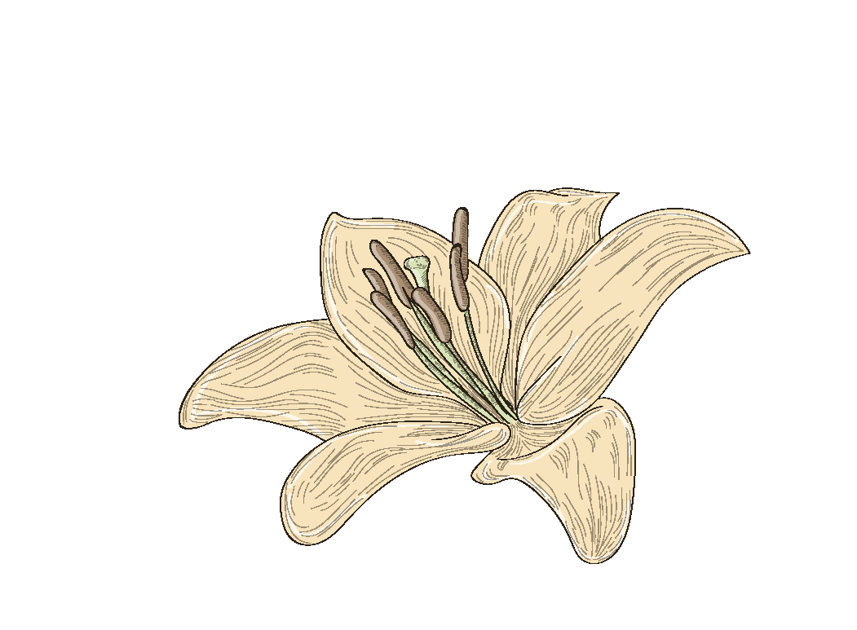
RESOURCES
Shutterstock. (2024, July 25). The 8 most beautiful but deadly flowers in the world. The Shutterstock Blog. https://www.shutterstock.com/blog/drop-dead-gorgeous-8-of- the-worlds-most-poisonous-flowers
Centre, A. P., & Centre, A. P. (2021, September 13). Daphne are flowering - animal poisons helpline. Animal Poisons Helpline - A FREE Poisons Information Helpline For Pet Owners. https://animalpoisons.com.au/news/daphne-are- flowering#:~:text=There%20are%20many%20species%20of,the%20 mouth%2C%20oesophagus%20and%20stomach.
AUTUMN CROCUS: Overview, uses, side effects, precautions, interactions, dosing and reviews. (n.d.). https://www.webmd.com/vitamins/ai/ingredientmono-282/autumn- crocus

